Slide 1
Software Engineering
Module 5-a
Software Requirements Techniques
Entity Relationship Modeling
Dr. Shai Koenig
Open University
Department of Computer Science

Slide 2
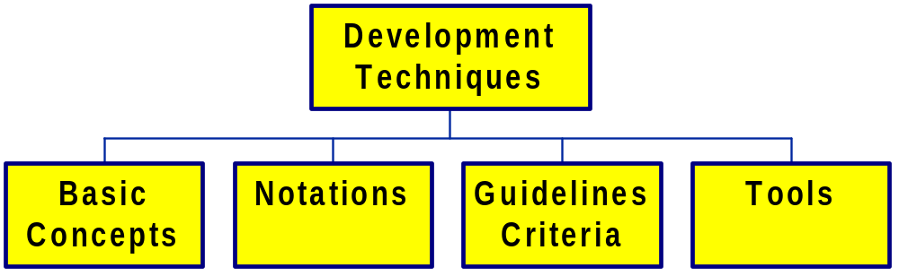
Development Techniques

Slide 3
Development Techniques
a conceptual framework for development
a common vocabulary
for expressing design decisions
for representing development work-products
how to use the concepts and notation
how to assess the work-product
assistance in making design decisions
for automating application of the development technique
for automating enforcement of rules

Slide 4
Development Techniques
By relieving the brain of all unnecessary work, a good notation sets it free to concentrate on more advanced problems.
Alfred Whitehead
An Introduction to Mathematics

Slide 5
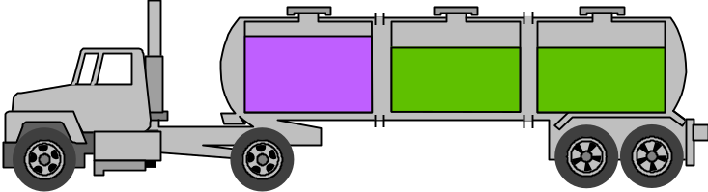
The role of automated tools & environments
Techniques
Process
Basic Concepts
Notations
Guidelines, criteria
Tools &
Environments
Techniques
Process
Basic Concepts
Notations
Guidelines, criteria
Tools &
Environments

Slide 6
Requirements Analysis & Specification Dimensions
Data
Function
Control

Slide 7
Requirements Analysis & Specification Dimensions
Data
Entity
Relationship
Modeling
Function
FSM’s /
Statecharts
Use Case /
Scenario
Modeling
Control

Slide 8
Development Techniques
Entity Relationship Modeling
Use Cases and Interaction Diagrams
Finite State Machines and Statecharts
Structured Analysis
Structured Analysis/RT
SW Architecture Styles
Object-based design approaches
Object-oriented design approaches
Design patterns
Structured Design
...

Slide 9
Data Base Design
user
requirements
specification
SRS
Requirements
analysis and
specification
conceptual
database
design
ER Model
Translate requirements
into conceptual schema of the database
Normalized
candidate
relations
logical
database
design
Transformation of the conceptual schema into a logical schema using the implementation data model
physical
database
design

Slide 10
ERM - Basic Concepts
Entity sets - objects of informational interest
  strong entities, weak entities
Attributes - describe characteristics of entities
  value set [domain]
  identifiers, descriptors, composite, multi-valued, derived
Relationship sets - association between entities
  degree [binary, ternary, ...]
  roles
  cardinality [1-1, 1-M, M-1, M-M]
  participation [optional, mandatory]
Class Hierarchies
  participation [optional, mandatory]
  disjoint or overlapping

Slide 11
Example - entity sets and their attributes
identifying
employee
composite
first-name
id-number
employee-name
last-name
multi-valued
dependent-name
tel-number
employment-length
start-date
simple
derived

Slide 12
Example - entity sets and their attributes
customer
name
id-number
loan-number
customer
loan
customer
street
amount
customer
city

Slide 13
Example - entity sets and their attributes
[alternative UML notation]
Customer
Id-number
name
street
city
Loan
number
amount

Slide 14
Example - many-to-many relationship
customer
name
id-number
loan-number
customer
borrower
loan
customer
street
amount
customer
city

Slide 15
Example - many-to-one relationship
customer
name
national id
number
loan-number
customer
borrower
loan
customer
street
amount
customer
city

Slide 16
Example - one-to-many relationship
customer
name
national id
number
loan-number
customer
borrower
loan
customer
street
amount
customer
city

Slide 17
Example - one-to-one relationship
customer
name
national id
number
loan-number
customer
borrower
loan
customer
street
amount
customer
city

Slide 18
Example - mandatory participation [total]
customer
name
id-number
loan-number
customer
borrower
loan
customer
street
amount
customer
city

Slide 19
Example - attributes of a relationship
customer
name
id-number
loan-number
customer
borrower
loan
customer
street
last
access-date
amount
customer
city

Slide 20
Example - Roles of a relationship
customer
borrower
loan
cust-banker
manager
employee
works-for
worker

Slide 21
Example: Weak entity sets & weak relationships
discriminator
payment-
date
loan-number
amount
payment-
number
payment-
amount
customer
borrower
loan-
payment
loan
payment
cust-banker
identifying
relationship
manager
employee
works-for
worker

Slide 22
Example: Specialization
account-
number
balance
depositor
account
customer
borrower
loan-
payment
loan
payment
cust-banker
manager
employee
works-for
worker

Slide 23
Example: Specialization & attribute inheritence
account-
number
balance
savings-
account
interest-rate
depositor
account
checking-
account
overdraft-
amount
customer
borrower
loan-
payment
loan
payment
cust-banker
manager
employee
works-for
worker

Slide 24
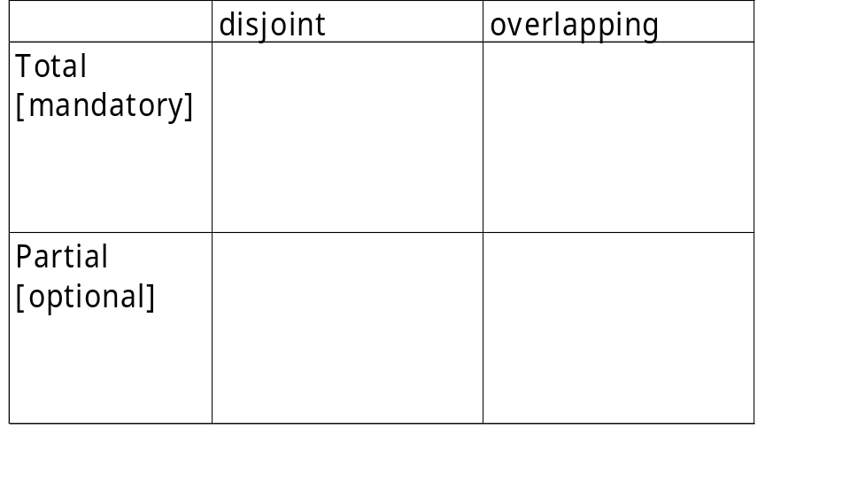
Example: Specialization & attribute inheritence
account-
number
balance
savings-
account
interest-rate
depositor
account
D
checking-
account
overdraft-
amount
customer
borrower
loan-
payment
loan
payment
cust-banker
D
O
manager
D
O
employee
works-for
worker

Slide 25
Example: Summary [without attributes]
savings-
account
depositor
account
D
checking-
account
customer
borrower
loan-
payment
loan
payment
cust-banker
manager
employee
works-for
worker

Slide 26
Example: UML version of Summary [without attributes]
Savings-
account
Terminology & Notation
Class Diagram
Classes
Objects
Relationships
  Associations/Links
  Role
  Reflexive
  Associative class [attributes]
  Qualified Association
  Multiplicity: 1..1[1], 0..1, 0..*[*]; 1..*
Account
depositor
0..*
Checking-
account
1..2
Customer
1..1
0..*
Loan
0..*
Payment-number
Qualified Association
Generalization/Specialization
Aggregation
Banker-of
loan-payment
Composition
0..*
0..1
Speaking perspective
1..1
manager
Payment
Employee
Works-for
Since
0..*
worker
works-for

Slide 27
Terminology
E-R Model/Diagrams | OO Model/UML Diagrams
Entity type | Class
Entity | Object
Relationship type | Association
Relationship | Link
Relationship attribute | Link attribute
Relationship constraints | Multiplicities
Recursive relationship | Reflexive association
IS-A relationship | Generalization/specialization
Weak entities and identifying relationships | Qualified association
 | Aggregation
 | Unidirectional/bi-directional association

Slide 28
Issues in designing an ER Model
whether to use an attribute or an entity set to represent a real-world object ?
whether a real-world concept should be represented most accurately by an entity set or a relationship set ?
whether to use a ternary relationship or a pair of binary relationships ?
whether to use a strong or a weak entity set ?
whether or not to use generalization ?
Keep it simple – do not over-model!
Keep the total number of entities and relationships asap
Avoid information loss
Use mapping rules to map an ER model into a logical schema using a logical data model [e.g., the relational model]

Slide 29
Data Base Design
user
requirements
specification
SRS
Requirements
analysis and
specification
conceptual
database
design
ER Model
Translate requirements
into conceptual schema of the database
Normalized
candidate
relations
logical
database
design
Transformation of the conceptual schema into a logical schema using the implementation data model
physical
database
design

Slide 30
Mapping an ER Model to a Relational Model
Strong entity sets
Weak entity sets
Relationships
  Many-to-many
  Many-to-one
  One-to-one
Multi-valued attributes
N-ary relationships
Generalization/specialization hierarchies

Slide 31
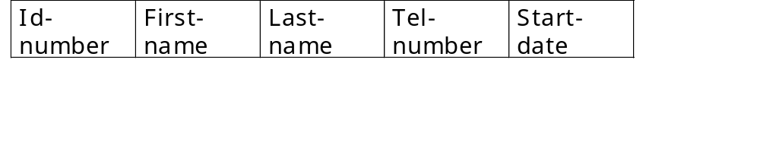
Example - mapping a strong entity set
employee
first-name
id-number
employee-name
last-name
dependent-name
tel-number
employment-length
start-date

Slide 32
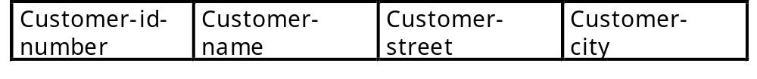
Example - mapping a strong entity set
customer
name
id-number
loan-number
customer
loan
cutomer
street
amount
customer
city

Slide 33
Mapping an ER Model to a Relational Model
For each strong entity set E
  create a relation R that includes all the simple attributes of E
  for a composite attribute, include only the simple components attributes
  choose one of the key attributes as the relation’s primary key

Slide 34
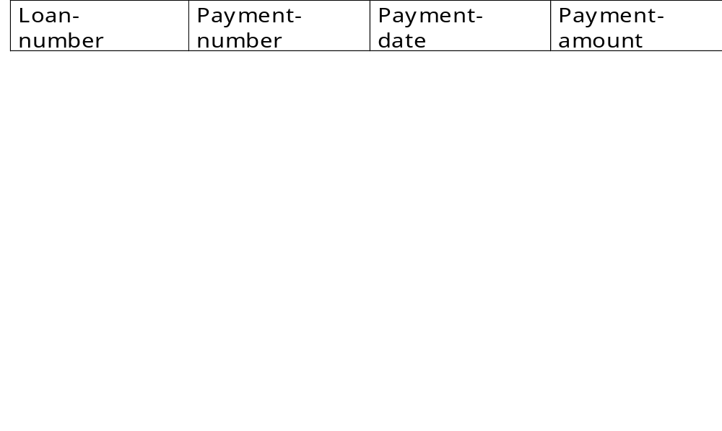
Example: mapping a weak entity set
payment-
date
loan-number
amount
payment-
number
payment-
amount
customer
borrower
loan-
payment
loan
payment
cust-banker
identifying
relationship
manager
employee
works-for
worker

Slide 35
Mapping an ER Model to a Relational Model
For each weak entity set W with owner entity set E
  create a relation R and include all simple attributes [or simple components of composite attributes] of W as attributes of R
  include as foreign key attribute of R , the primary key attribute(s) of the relation that corresponds to the owner entity set E.

Slide 36
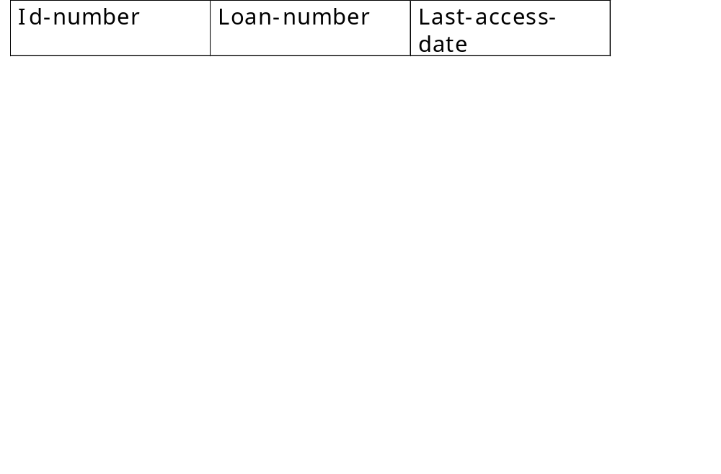
Example - mapping a many-to-many relationship
customer
name
id-number
loan-number
customer
borrower
loan
cutomer
street
last
access-date
amount
customer
city

Slide 37
Mapping an ER Model to a Relational Model
For each binary M:N relationship set R
  create a new relation S to represent R
  include as foreign key attributes in S the primary keys of the relations that represent the participating entity sets - their combination will form the primary key of S
  include any simple attributes of the M:N relationship set as attributes of S.

Slide 38
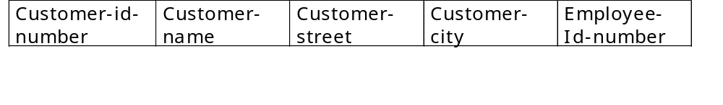
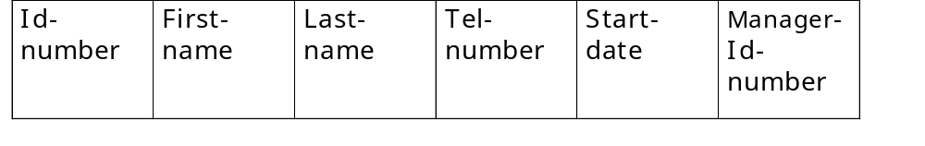
Example: mapping a many-to-one relationship
loan-number
amount
customer
borrower
loan
cust-banker
manager
employee
works-for
worker

Slide 39
Mapping an ER Model to a Relational Model
For each binary 1:N relationship set R
  identify the relation S that represents the participating entity type at the N-side of the relationship set
  include as foreign key in S the primary key of the relation T that represents the other entity set participating in R
  include any simple attributes of the 1:N relationship set as attributes of S.

Slide 40
Mapping an ER Model to a Relational Model
For each binary 1:1 relationship set R
  identify the relations S and T that correspond to the entity sets participating in the relationship set R
  choose one, for example S, and include as foreign key in S the primary key of T
  it is better to choose an entity set with total participation in R in the role of S
  include all the simple attributes of the 1:1 relationship set R as attributes of S

Slide 41
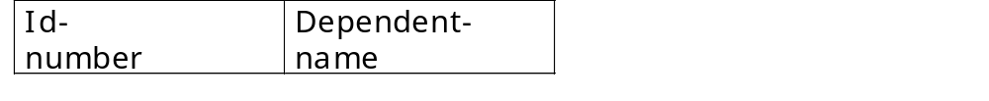
Example - mapping a multi-valued attribute
employee
first-name
id-number
employee-name
last-name
dependent-name
tel-number
employment-length
start-date

Slide 42
Mapping an ER Model to a Relational Model
For each multi-valued attribute A
  create a new relation R that includes an attribute corresponding to A plus the primary key attribute K of the relation that represents the entity set or relationship set that has A as an attribute
  the primary key of R is then the combination of A and K.

Slide 43
Mapping an ER Model to a Relational Model
For each n-ary relationship set R [with N>2]
  create a new relation S to represent R
  include as foreign key attributes in S the primary keys of the relations that represent the participating entity sets
  include any simple attributes of the N-ary relationship set as attributes of S.
a
A
a | b | c | r
b
B
R
r
c
C

Slide 44
Mapping an ER generalization hierarchy
In mapping a generalization hierarchy to the relational model, consider the nature of the hierarchy.
Mapping alternatives
Three Relations
Two relations
One relation
Notes:
The “three relation” option works for any constraints on the specialization hierarchy. It requires a join to get the information for a single subclass.
The “two relation” option builds the join into the schema. This option works well only when the hierarchy is both total [otherwise entities are “lost”] and disjoint [otherwise attributes are duplicated]. To get the whole superclass we will need an union operation.
The “one relation” option will have null values for the attributes of the “other” subclass. This is not recommended if the subclasses have many attributes. However, this option is preferable if the subclasses have only a few attributes, since this option obviates the need for join operations.

Slide 45
Example: Specialization & attribute inheritence
License
number
Engine
size
Car
Type
[automatic, manual]
Vehicle
Truck
Load

Slide 46
Example: Specialization & attribute inheritence
License
number
Engine
size
Car
Type
[automatic, manual]
Vehicle
Truck
Load
Mapping alternatives
Three relations
Two relations
One relation

Slide 47
Mapping an ER generalization hierarchy
The “three relation” option works for any constraints on the specialization hierarchy. It requires a join to get the information for a single subclass.
The “two relation” option builds the join into the schema. This option works well only when the hierarchy is both total [otherwise entities are “lost”] and disjoint [otherwise attributes are duplicated]. To get the whole superclass we will need an union operation.
The “one relation” option will have null values for the attributes of the “other” subclass. This is not recommended if the subclasses have many attributes. However, this option is preferable if the subclasses have only a few attributes, since this option obviates the need for join operations.

Slide 48
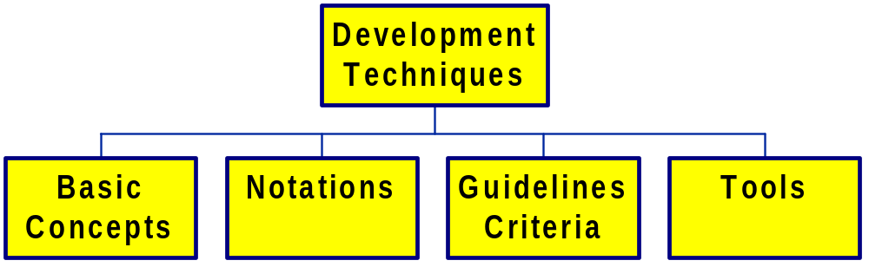
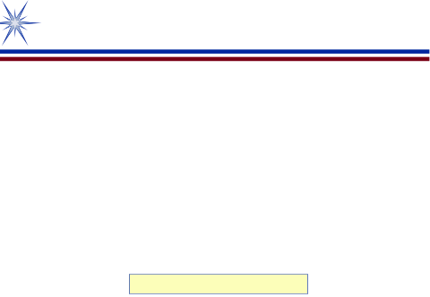
Summary of the ER Model
entity sets
relationship sets
attributes
class hierarchies
conceptual schema guidelines
mapping rules
DB dev tools
Oracle designer
:

Slide 49
Summary - Basic Concepts
Entity sets - objects of informational interest
  strong entities, weak entities
Attributes - describe characteristics of entities
  value set [domain]
  identifying, descriptor, composite, multi-valued, derived
Relationship sets - association between entities
  degree [binary, ternary, ...]
  roles
  cardinality [1-1, 1-M, M-1, M-M]
  participation [optional, mandatory]
Class Hierarchies
  participation [optional, mandatory]
  disjoint or overlapping

Slide 50
Summary - Notation
entity-set
relationship
-set
attribute
Specialization /
generalization
weak
entity-set
weak
relationship
-set
derived
attribute
Optional / partial
participation
Mandatory / total
participation
multi-valued
attribute
attribute
identifying
attribute
composite
attribute
attribute

Slide 51
Summary - Notation for cardinality/participation
many-to-many
A
B
many-to-one
A
B
one-to-one
A
B
total participation
A
B

